Slide 1

Yelp Data to Predict Affluency
By: Brian Jankowitz

Slide 2
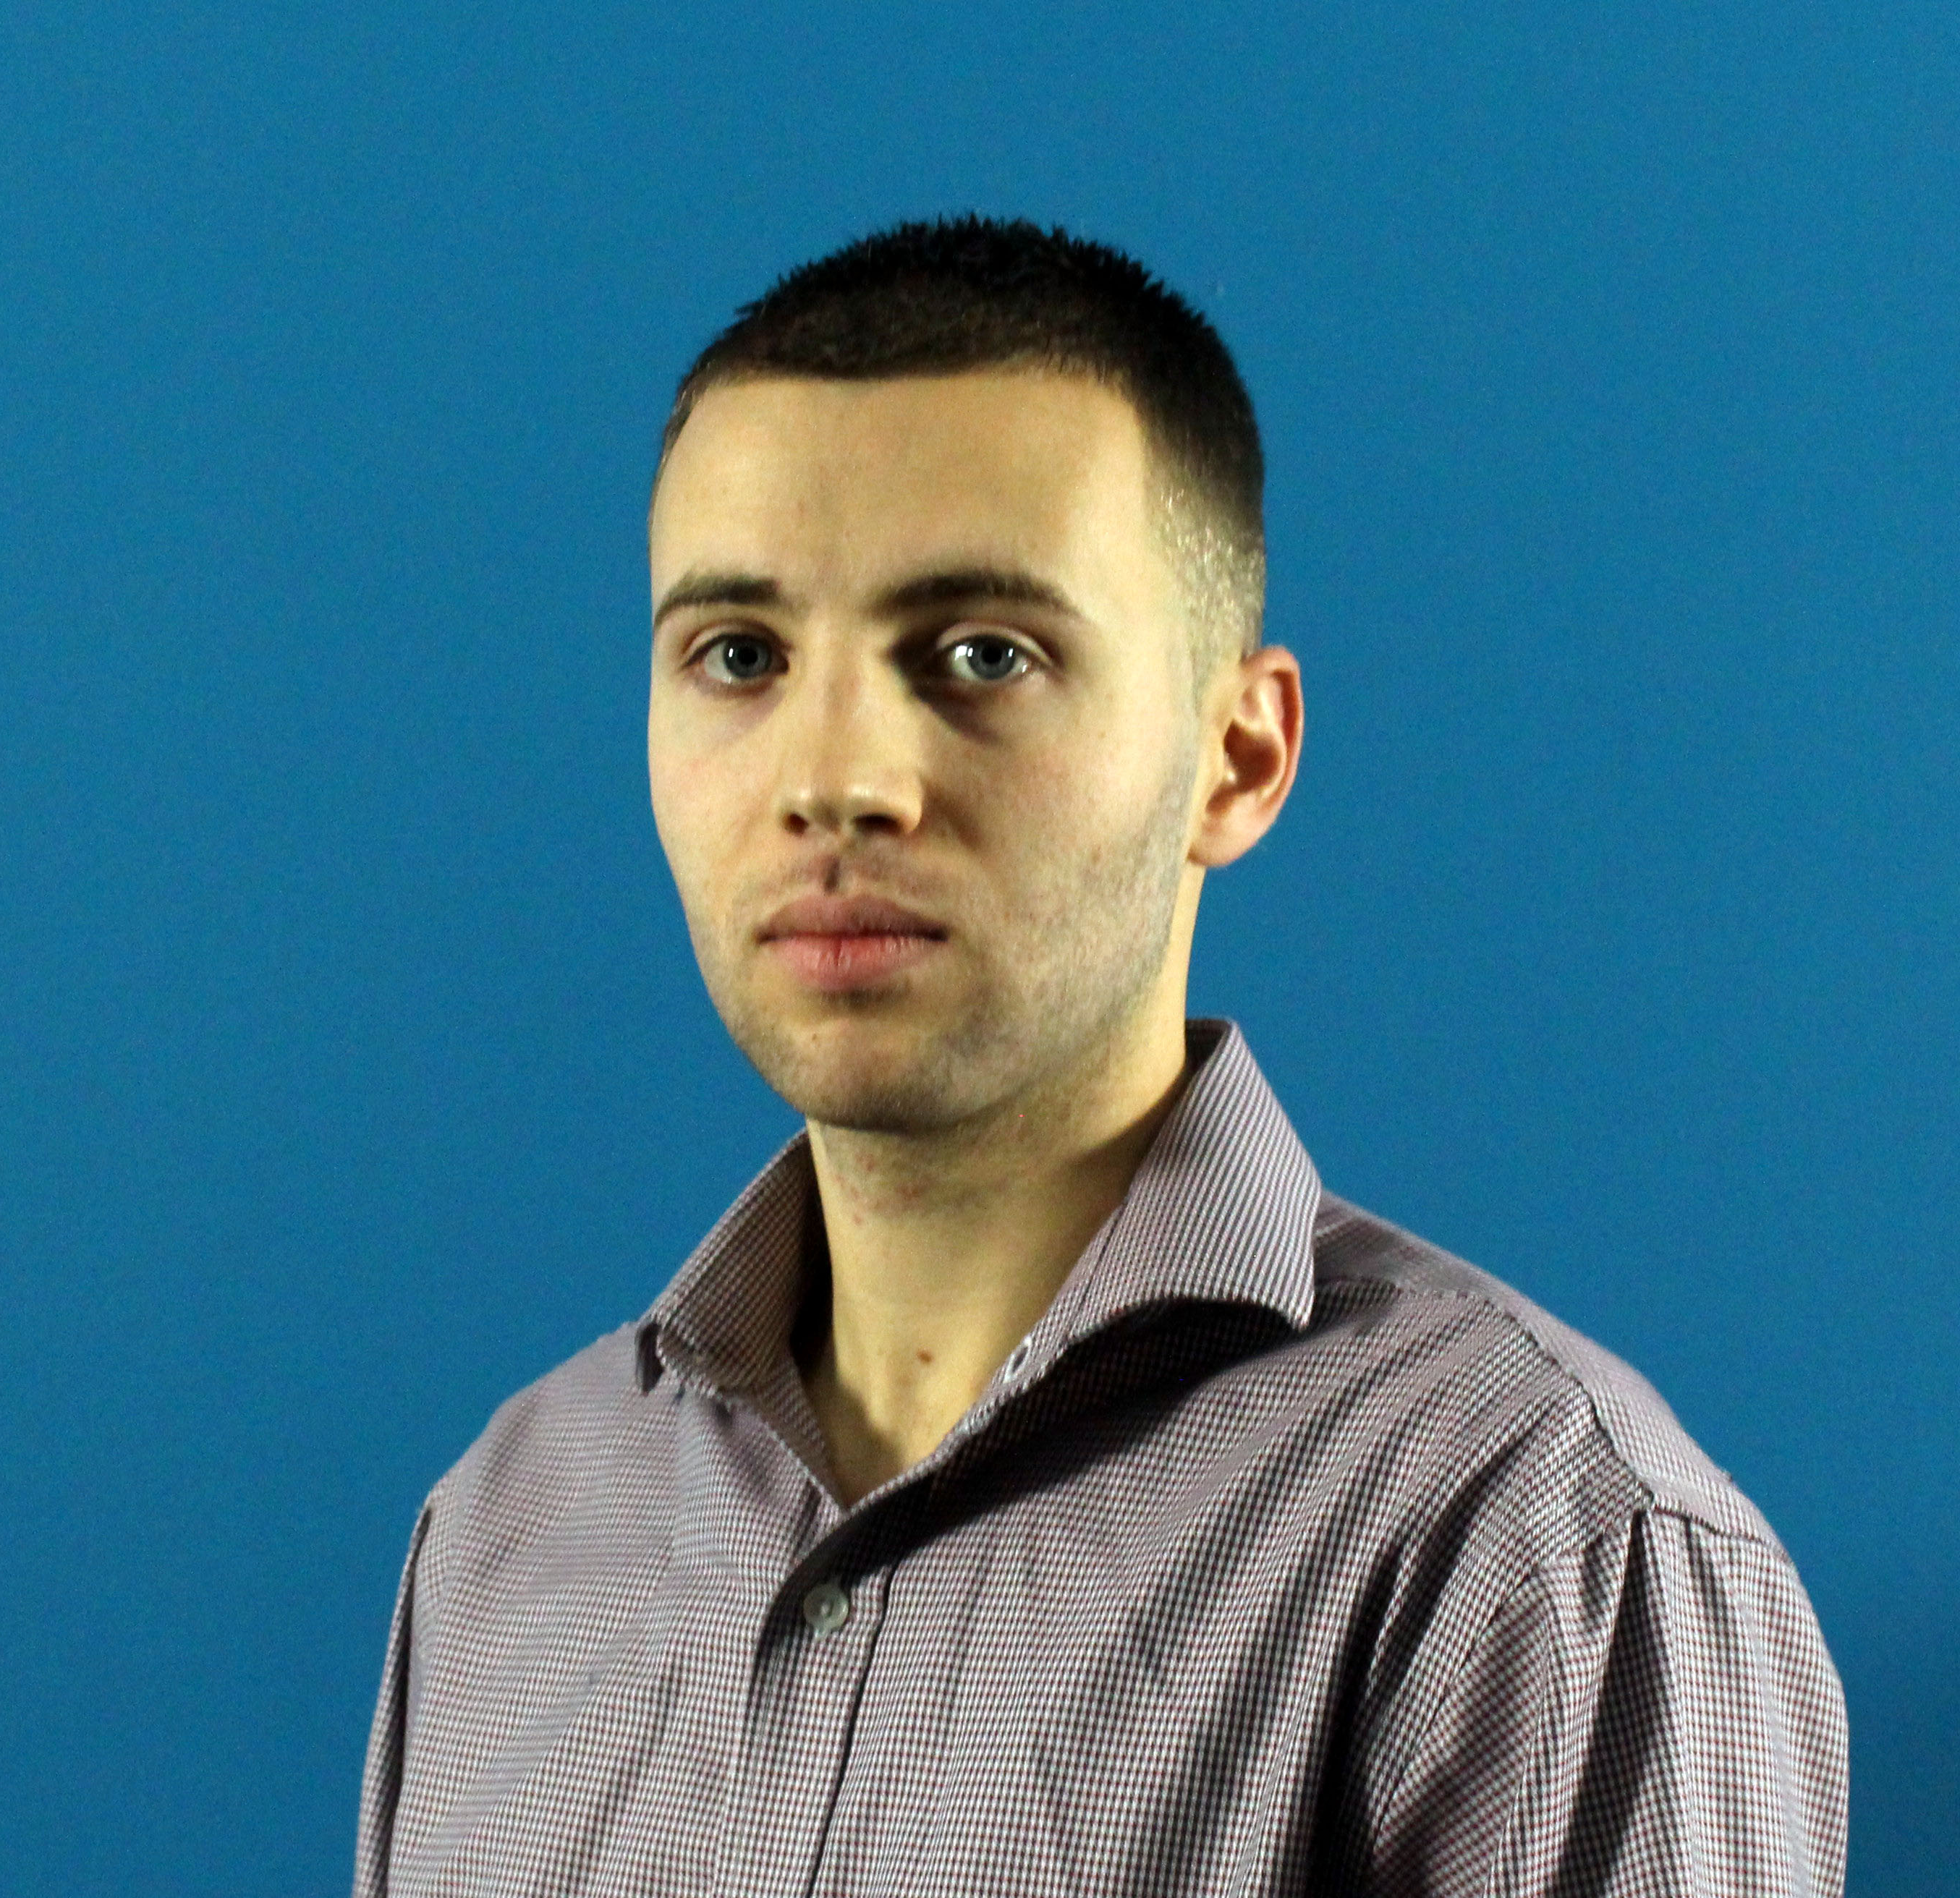
Brian Jankowitz
Data Analyst
Presented in front of audiences 300+ people
Background data analyzation

Slide 3
Agenda
What is Yelp?
Problem Statement
Data Gathering
Analyzing Data
Modeling
Model Selection
Conclusion
Recommendations

Slide 4
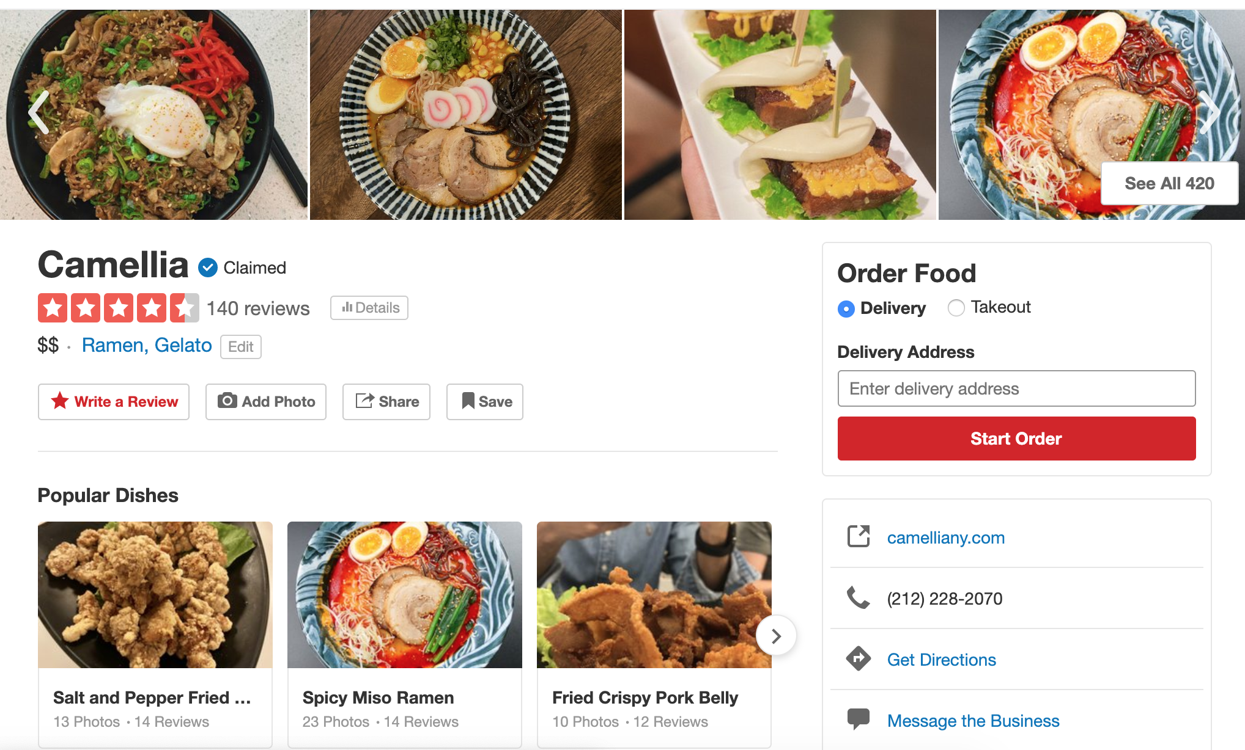
What is Yelp?
A place for business reviews
Crowd-sourced

Slide 5
Problem Statement
How can we target people in non affluent area to help provide them health insurance
Find non-affluent area in a non-traditional way
Use of big data related to commercial activity and cost of product and
services as an indicator for affluency.
Increase healthcare coverage
Market to those people
Facts (US Census Bureau)
In 2018, 28 million people without health insurance
72.2% of people 100% or more below that poverty line are uninsured

Slide 6
Data Gathering- Yelp
Scrapped Yelp
Gathered information on businesses in all 5 boroughs of New York City
Was this information enough by itself? No
Get more data
Round 1: 5000 places to only 1200 places
Round 2: 32000 places to only 12000 places

Slide 7
Data Gathering- Income
IRS data
Last year available 2017
Number of returns and amount for AGI
Why AGI and not just income?
To adjust for other areas
Each person pays different taxes
Affluenct > 25=

Slide 8
Problems with Data- Outliers
Outlier
New York City
Outlier

Slide 9
Coverage of New York City
Dark vs light colors
Business density

Slide 10
Borough | Population (2018)
The Bronx | 1,432,132
Brooklyn | 2,582,830
Manhattan | 2,278,906
Queens | 2,278,906
Staten Island | 476,179

Slide 11
EDA
3($$$) and 4($$$$) less than 10%
1($) and 2($$) more than 90%

Slide 14
Modeling
Model | Train | Test | Sensitivity | Specificity
Logistic Regression | 83.1% | 83% | 22% | 96%
KNN | 97.8% | 82% | 96.4% | 96.1%
Decision Trees | 100% | 99.9% | 21.9% | 96.1%
Bagging | 99.9% | 99% | 21.9% | 96.1%
Random Forest | 99.9% | 99.9% | 21.9% | 96.1%
Baseline Train | Baseline Test
82.3% | 82.3%

Slide 15
Model Selection

Slide 16
Conclusion
We can predict the affluency of an area
High true positives
There are some questions about the data
How accurate is this?
Tribecca
Richest zip code in New York City (source: Business Insider)
Don Bella Pizza rated $
More research needs to be done

Slide 17
Recommendations
More time should be allocated to this
Look at more expensive areas
Times Square and World Trade Center
Plain slice of pizza $2, Times Square $4+
Use Big data in other ways
Apartment prices
Express trains
How close to train (only certain areas)
Use big group to collaborate, see if $$ can be used to supplement another model for predicting prices

